Slide 1

We Go Jim!
Fitness App
IS 699 - Information System Project
Presented By:
Adrian Lopez
Prayag Padwal
Gnan Akshith

Slide 2
Table of contents
01
Business Model
02
What we offer?
03
Lets Go Jim!
04
Conclusions
Freemium vs Premium
Enhanced Fitness Journey
App Demo
Future Scope

Slide 3
Business Model
We Go Jim:
Dual-subscription model app
Freemium: AI Generated Workout & Meal Plans
Premium: Personal Training and Nutrition Plans

Slide 4
What we offer:
Enhanced fitness goals, interactive AI, Personal Trainers and nutritionists, & Social Connectivity
Workout Plans
Meal Plans
Leaderboard Between Friends
Elevate your fitness journey!

Slide 5
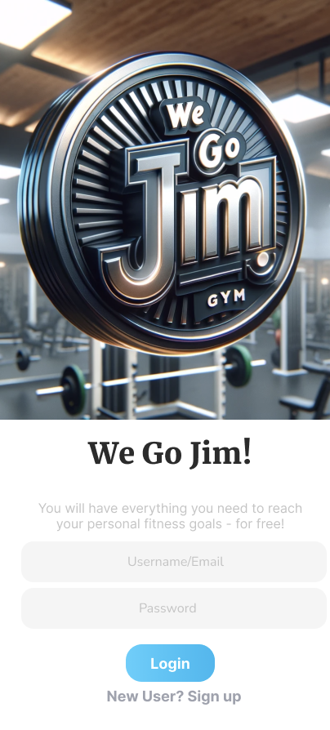
Lets Go Jim!

Slide 6
Conclusions
Revolutionizes the fitness landscape with its dual-subscription model
Freemium, AI Generated Plans
Premium, Personal Training & Nutrition
Advanced AI technology, interactive features, and a focus on community through Friend leaderboards
Elevate your journey with a unique blend of innovation, customization, and social connectivity

Slide 7
Future Scope
With more resources, we can integrate an option that will let you host competitions among different individuals and communities, that will help us go GLOBAL.

Slide 8
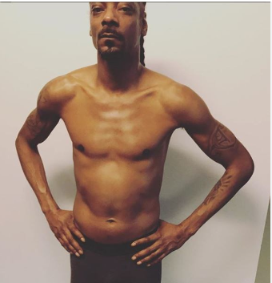
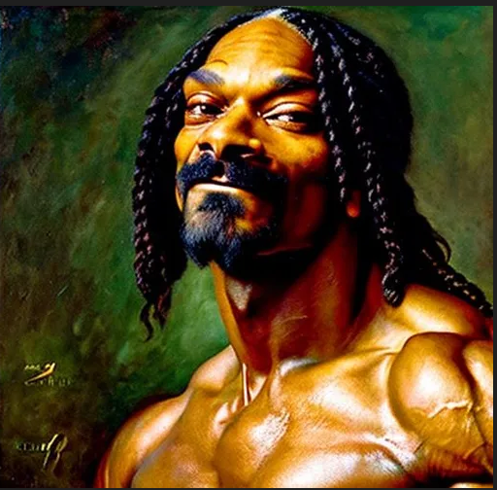
Effects of ‘We Go Jim!’
Before
After

Slide 9
Thank you!
Do you have any questions ?

